Slide 1
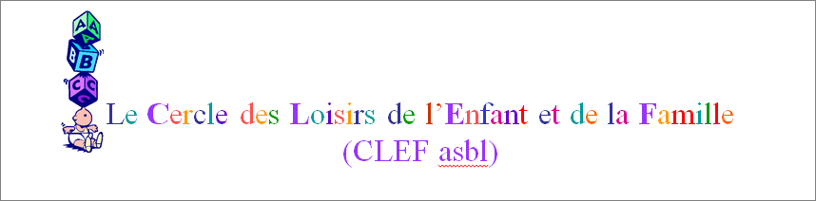

Slide 2
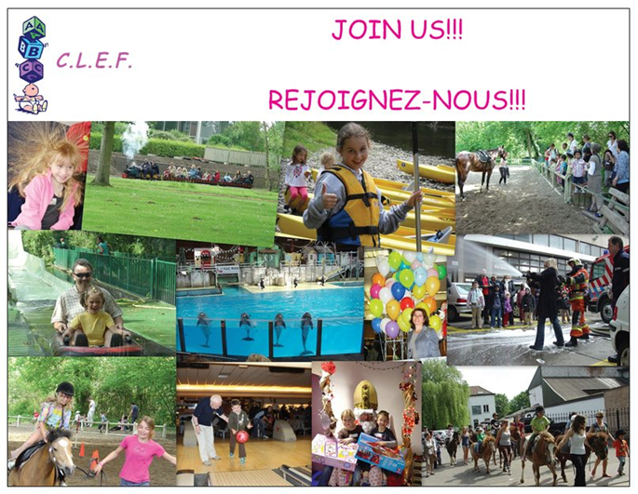

Slide 3
Why should my family register?
You may have just arrived with your family or you have been here for a while and you are looking for some nice weekend activities to do with your children?
Every month, except in August, CLEF organises at least one activity, such as visits to interesting museums or amusement parks, as well as outings outside Brussels which will give you a better insight into Belgian culture. Our activities usually benefit from group discounts and are usually free for children.
CLEF also organises regular activities such as our traditional Kayaking in early July, our big St Nicolas party in December and one annual flea market (Brocante) where you may buy and resell children clothes or toys which are no longer needed.
C.L.E.F. is the right place to come!

Slide 4
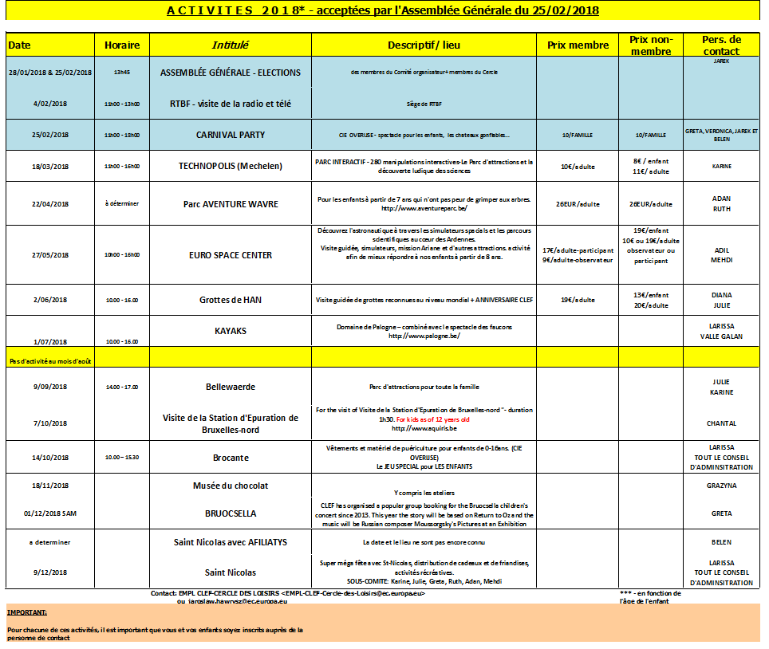

Slide 5
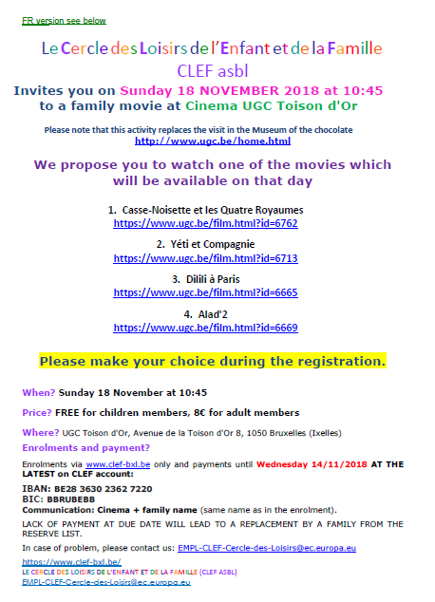
Every month you will get an event invitation organised by our volunteers

Slide 6
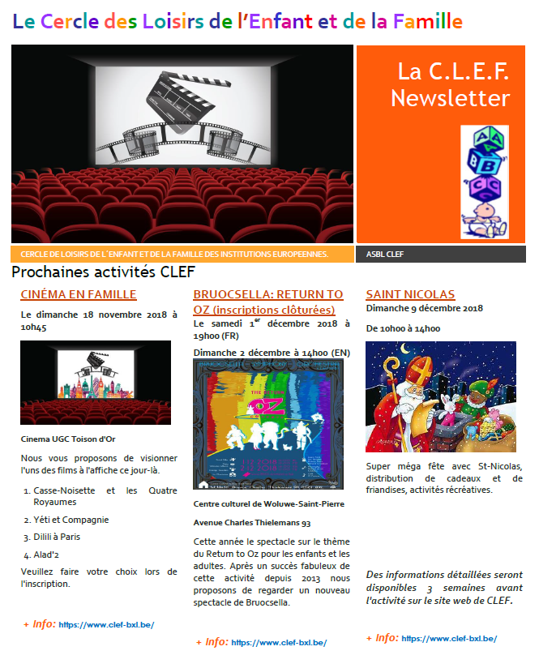
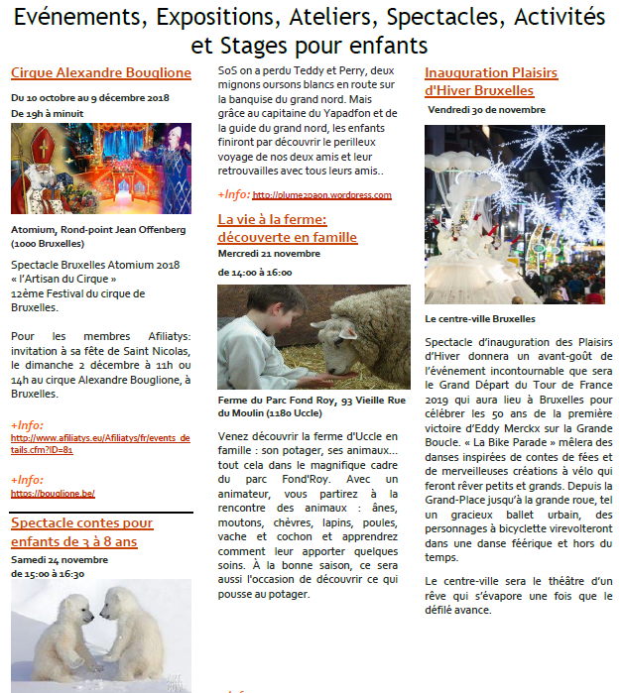
Every month you will also get the Newsletter of the events in Belgium targeted for families

Slide 7
Next event: soon on our website!!
CHECK ON www.clef-bxl.be

Slide 8
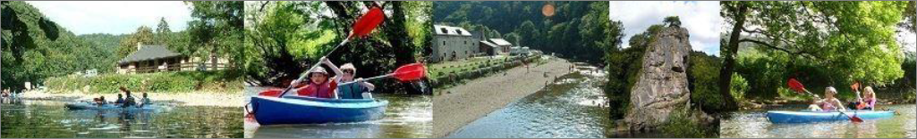
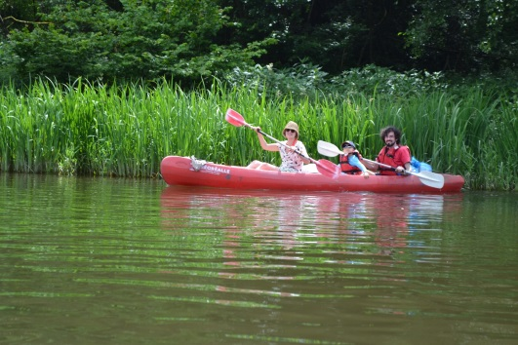
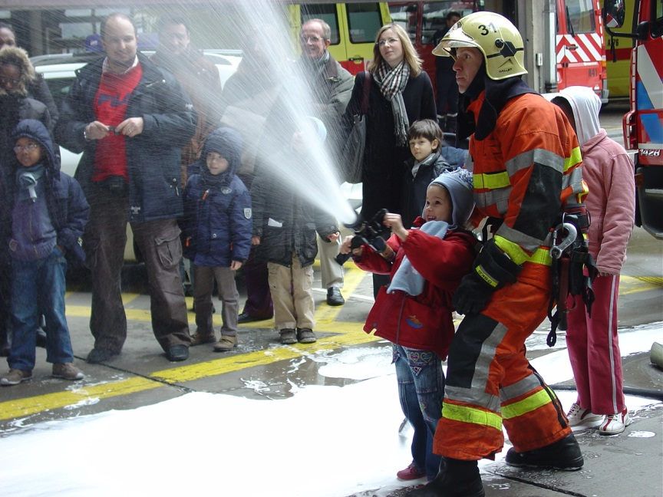
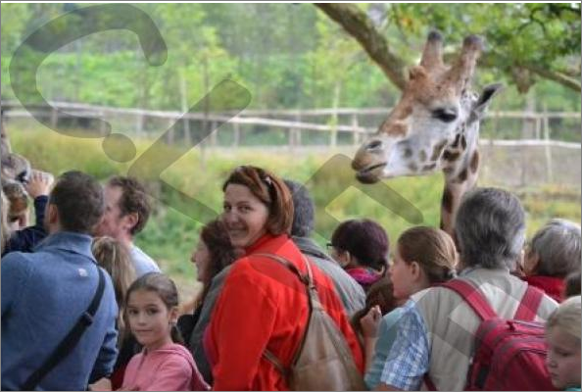
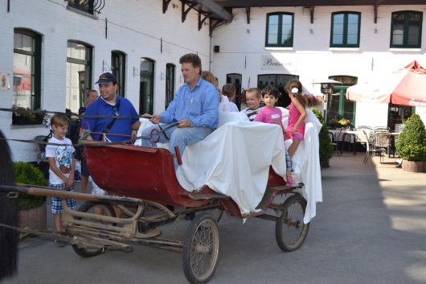
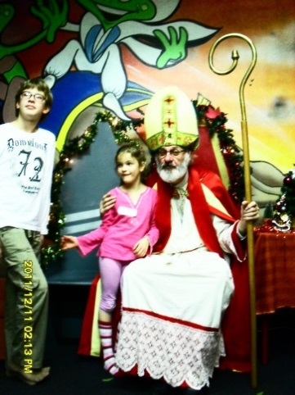
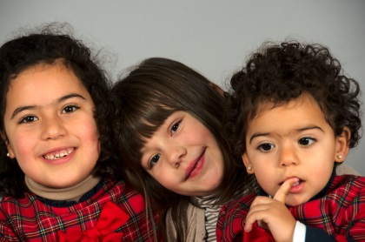
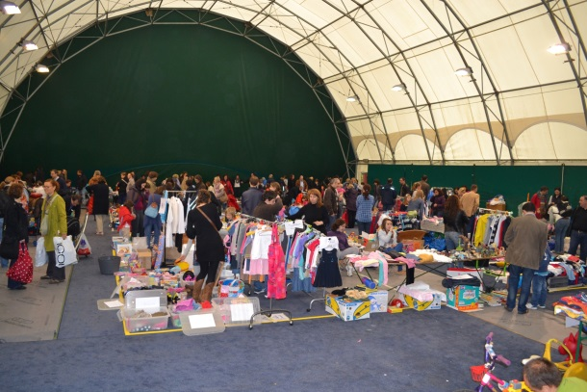
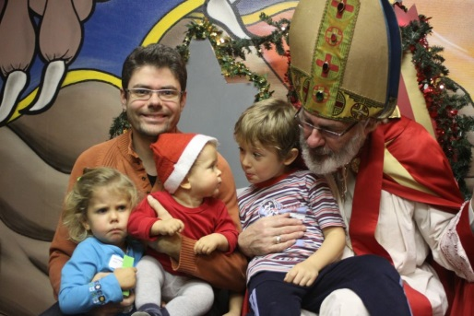

Slide 9
If you are interested in sharing some adventures in a relaxed atmosphere, please do not hesitate to contact us and we will send you further information about our activities.
CLEF can help you and your family integrate into your new life here in Belgium.
Contact persons :
Julie FRANÇOIS, President (tel: 99249)
Ruth MATA RODRÍGUEZ, Vice-president (tel: 90848)
EMPL-CLEF-Cercle-des-Loisirs@ec.europa.eu

